Slide 1
PHP With SQL!
CPSC 2030

Slide 2
Creating stored procedures in SQL
Temporarily changing the Delimiter.
Normally, a semicolon is used to separate multiple SQL statements.
However when writing a script to create a procedure, we need to use the semicolon as part of the SQL.
We use the DELIMETER command to change it
DELIMETER //
Changes it to //
DELIMTER
changes it back to ;

Slide 3
CREATE PROCEDURE
We use the create procedure command to create a procedure.
We precede it with a DELIMTER command
And follow it with a DELIMTER command
DELIMTER //
CREATE PROCEDURE myProc()
BEGIN
SELECT * from table;
END //
DELIMTER ;

Slide 4
Why PHP, what is it good for?
2 Basic uses
Generating static content that would be annoying to manually create
Makes it more maintainable
Generating Dynamic content
Content that is pulled from a database or other sink
Content that is dependent input to the page such as the query string
Some of it can be accomplished with JavaScript as well

Slide 5
What does server side scripting mean
Web Browser makes a request for the PHP page
The server loads the PHP page and sends it to the PHP interpreter
Runs the PHP code and generate the output
The modified file is then sent to the user
So you don’t get the Original PHP page
file
PHP interpreter
modified file

Slide 6
Basics
<?php ?>
PHP scripts are usually partially, or entirely embedded in HTML files using
<?php
code
?>
Syntax

Slide 7
Simple example
the two commands to send create output is either echo or print.
They are more or less the same, with print returning 1(one)
<!DOCTYPE html>
<html>
<body>
<h1>My first PHP page</h1>
<?php
echo "Hello World!";
?>
</body>
</html>

Slide 8
Resulting page
<!DOCTYPE html>
<html>
<body>
<h1>My first PHP page</h1>
Hello World!
</body>
</html>

Slide 9

Functions
REuse your code
REduce the amount of work you do and your code complexity
REcycle your ideas
We can put code in functions
This is the first step to re-use
We can put these function in modules
This is the second step to re-use
We can then include these modules in our php code
We can reuse function across files.

Slide 10
How to create a php library
Put your re-usable functions in a file, eg.. example.php
in the files you want use these function have the line:
require_once (“example.php”);
Start re-using your functions
For reference: http://php.net/manual/en/function.require-once.php
There is also require
require_once will check if the file has been previously included, which might happen with nest dependencies.
For our use case, it doesn’t really matter which you use
require and include are almost the same but:
require will stop the script if there is an error
include will give a warning

Slide 11
Defining Variables
All variables start with '$'
$car = "Toyota";
Variables last only for a single pass of the script
They are destroyed/freed afterwards
If you variables needs to last more than one script execution consider session variables

Slide 12
The Output, writing to the page
To write to the output use the echo command
echo “The information I want to put on the page”
The echo inserts text where the <?PHP?> is in the html page
We can have more than one echo
we can put echo in loops

Slide 13
Two types of strings
Single quoted strings
Single quote are literal strings, they are interpreted as is
‘This is a $count String’, will appear exactly like that
Double quoted strings
Double quoted strings, will have any variables within it replaced with the variable value.
Assuming $count = 5
“This is a $count String” will be
This is a 5 string

Slide 14
use . (dot) to concatenate strings
. is the concatenation operator
example
“string1”.”string2”

Slide 15
Arrays
We use arrays to store list of things
$cars = array("Volvo", "BMW", "Toyota");
User the array key word to create an array
User Square brackets and index to access an array
echo "I like " . $cars[0] . ", " . $cars[1] . " and " . $cars[2] . ".";

Slide 16
Arrays part 2
User the count function to get the length of an array
count($cars)
This is so old school!!!
array_push($cars,”Nissan”, “Datsun”);
Use array_push to add to the end of an array
Full list of array functions can be found here:

Slide 17
Associative arrays
Associative arrays allows you to access elements via a name instead of an index
This is useful, since we can use the sql column names
$age = array("Peter"=>"35", "Ben"=>"37", "Joe"=>"43");
$age['Peter'] = "35"; $age['Ben'] = "37"; $age['Joe'] = "43";

Slide 18
For Loops
Just like for loop in any other language
If you know one for loop, you know them all
for (init counter; test counter; increment counter) { code to be executed; }
<?php for ($x = 0; $x <= 10; $x++) { echo "The number is: $x <br>"; } ?>

Slide 19
If statements
Just like if statements in other language
if (condition) { code to be executed if condition is true; } else { code to be executed if condition is false; }
<?php $t = date("H"); if ($t < "20") { echo "Have a good day!"; } else { echo "Have a good night!"; }
?>

Slide 20
Types
String
Integer
Float (floating point numbers - also called double)
Boolean
Array
Object
NULL
Resource

Slide 21
Special variables
PHP is smart, there are some special predefined global variablesa
$_SESSION
used in conjunction with session_start
used to store information across multiple pages for the same user.
When you call session_start, magic happens in the background with session cookies
And the server will know that you are the same person visiting different part of the site
You can store and retrieve information with $_session

Slide 22
$_GET
Get allows us to access the parameters in the query string.
Query strings is one way to communicate information from one page to another page.
It stores this information as a key value pair in the URL

Slide 23
Manually creating query strings
http://testsite.ca/endpoint.php?data1=343232&data2=goat
add more parameters with &
has value 343232
URL and filename
Parameter called data1
question mark indicate start of query string

Slide 24
Accessing SQL From PHP
By itself PHP isn’t useful
The ability to read from a database increases it’s usefulness
We can generate information from the user information
https://www.w3schools.com/php/php_mysql_connect.asp
<?php $servername = "localhost"; $username = "username"; $password = "password"; // Create connection $conn = new mysqli($servername, $username, $password); // Check connection if ($conn->connect_error) { die("Connection failed: " . $conn->connect_error); } echo "Connected successfully"; ?>

Slide 25
Getting information from SQ L
Open SQL connection
Run Query
Close connection
Generate Text

Slide 26
Connecting to the database
We use the mysqli interface to create a connection to our database
$conn = new mysqli($servername, $username, $password);
Note that, mysqli is class, in which we use the keyword new to create an instance of the object.
Library already built in to PHP
$conn is the connection object
If you want connect to different databases you use a different connector class.

Slide 27
Running queries
on the connection object ($conn) there is a method called query, in which we can run SQL queries.
$sql = "SELECT id, firstname, lastname FROM MyGuests"; $result = $conn->query($sql);
The above example runs SQL, but we shouldn’t do that
$sql = “CALL getIdx()"; $result = $conn->query($sql);
We should use our stored procedures
works the same as having a select statement in the text.

Slide 28
the msqli_result class
http://php.net/manual/en/class.mysqli-result.php
The object is a Traversable/iterable container.
array fetch_fields ( void )
Get an array of all the column names, if you don’t know them already
return an array of field objects
array fetch_assoc ( void )
Get the current row as an associative array, where you can use the column name to access the values.
Advances the internal pointer to the next row

Slide 29
the msqli_result class continued
bool data_seek( int $offset)
Changes where the internal pointer points to
can be used to reset the object back to the top position with data_seek(0)
mixed fetch_all( [ int $resultype = MYSQLI_NUM])
get all the rows
Valid parameters are MYSQLI_NUM, MYSQLI_ASSOC, or MYSQLI_BOTH
There are more methods go look at the manual

Slide 30
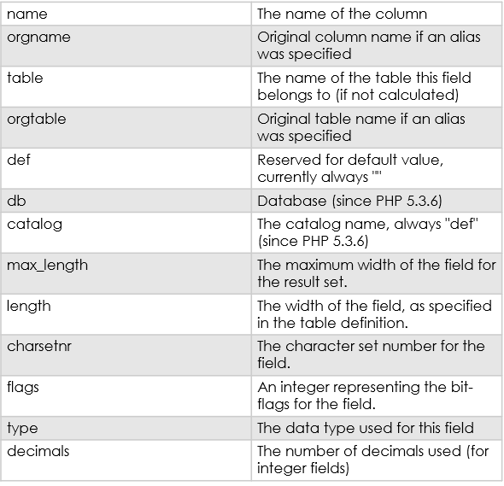
fetch_fields
http://php.net/manual/en/mysqli-result.fetch-field.php
fetch_feilds returns an array of objects that contains information about the colum
properties include:

Slide 31

Things we can do
First we must get comfortable with string manipulation.
Then we can construct custom SQL queries
with these queries we can generate HTML pages, XML pages, JSON pages, or even CSS pages.
Hopefully string manipulation is something you mastered
Or at least want to master
Or you will end up like the picture on the right some days

Slide 32
Generating a custom component
Create a function to generate the html necessary for the component
headers, footers, tables, menus, specialized presentation
Create a template once, use many times
Same can be accomplished on the client side with JavaScript
Query the database for the necessary information
use the function and data from the SQL to generate the component

Slide 33
Generating tables
To generate a table
You loop through all the rows, and produce the respective td elements
Basically use PHP to write the equivalent HTML code, using information from the database to fill in the table.

